Slide 1
A Nonparametric Method for Early Detection of Trending Topics
Zhang Zhang
Advisor: Prof. Aravind Srinivasan

Slide 2
Presentation
Motivation
Data Model
Research on Improving the Model
Implementation
Validation of Implementation
Project Schedule

Slide 3
Motivation
Global Human population is geographically distributed, multimodal sensors.
Traditionally, Journalists, Explorers, 007
Nowadays, blogs, forums, product reviews, social networking
Twitter : 200 million active users around globe
Tweets are limited to 140 characters
Short delays in reflecting what its users perceive

Slide 4
Empirical Observation
Trending topics can typically be detected by a sudden high-magnitude spike in activity over some baseline of activity.
The sudden spike is often preceded by lower magnitude activity that is indicative of the topic’s imminent popularity.
Predict whether a topic will become trending

Slide 5






Data Model
$$ℙ(s generated by q)∝exp⁡(−γd\left(s,q\right))$$
$$d\left(s,q\right) is symmetric, positive definite, and convex distance$$
$$R_{+}$$
$$R_{−}$$
$$+$$
$$−$$
$$t_{1},……t_{n}$$
$$q_{1},……q_{m}$$
Topics that were trending at some point during the period of interest
Topics that were not trending at some point during the period of interest

Slide 6
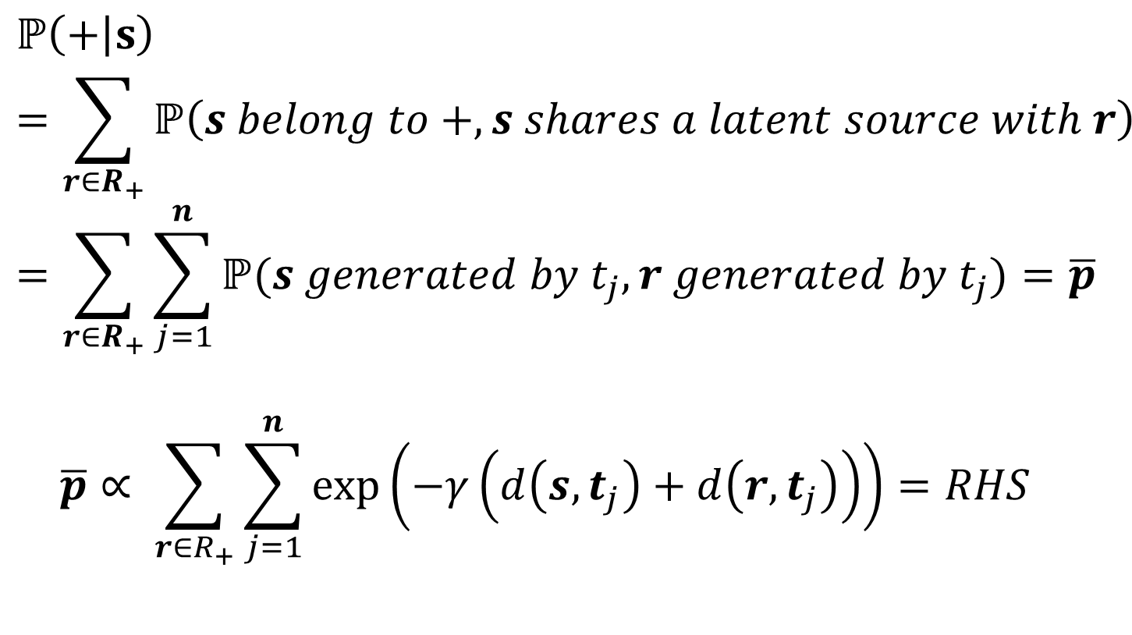
Data Model
$$ℙ\left(+ | s\right)=\sum_{r∈R_{+}}{ℙ\left(s belong to +, s shares a latent source with r\right) }=\sum_{r∈R_{+}}{\sum_{j=1}^{n}{ℙ(s generated by t_{j}, r generated by t_{j})}=\overline{p}}$$
$$\overline{p}∝ \sum_{r∈R_{+}}{\sum_{j=1}^{n}{\exp\left(−γ\left(d\left(s,t_{j}\right)+d\left(r,t_{j}\right)\right)\right)=RHS}}$$

Slide 7
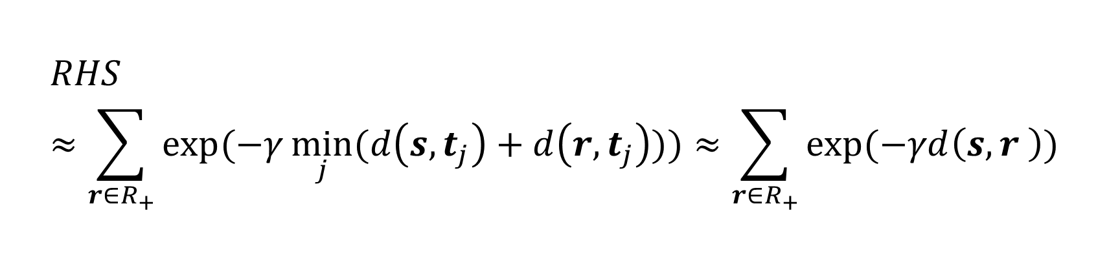
Data Model
$$RHS≈\sum_{r∈R_{+}}{exp⁡(−γ\min_{j}{(d\left(s,t_{j}\right)+d\left(r,t_{j}\right)))}≈\sum_{r∈R_{+}}{exp⁡(−γd\left(s,r \right))}}$$

Slide 8
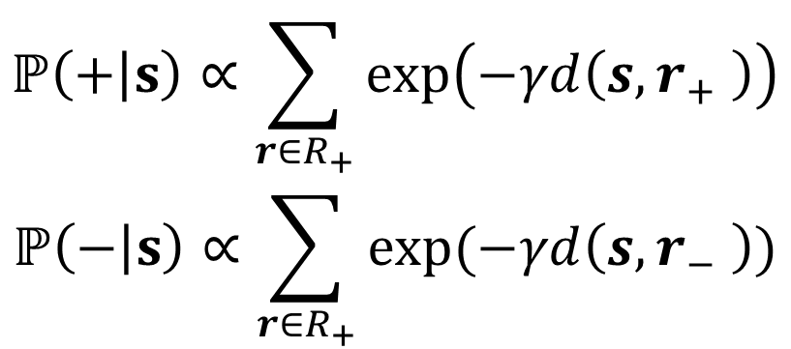

Data Model
$$ℙ\left(+ | s\right)∝\sum_{r∈R_{+}}{\exp\left(−γd\left(s,r_{+} \right)\right)}$$
$$ℙ\left(− | s\right)∝\sum_{r∈R_{+}}{exp⁡(−γd\left(s,r_{−} \right))}$$
$$f\left(s\right)=sgn\left(R\left(s\right)−θ\right) where R\left(s\right)=\frac{ℙ\left(+ | s\right)}{ℙ\left(− | s\right)}$$

Slide 9
Implementation – Data Collection : Twitter API
During a sample window, we collect N examples of topics that trended at least once and N examples of topics that were not trending.
We then sample Tweets from the sample window and label each tweet according to the topics mentioned.
Finally, we construct a reference signal for each topic based on the Tweet activity corresponding to the topics.

Slide 10
Implementation – Topics
Filter out topics : a. whose rank was never better than or equal to 3
b. topics that did not trend for long enough
c. topics that reappear multiple times during sample window
Collect not trending topics:
a. Sample a list of phrases consisting of n-grams. Filter out the n words that contain any topic trending during the sample window
b. Remove the n-grams shorter than three characters

Slide 11
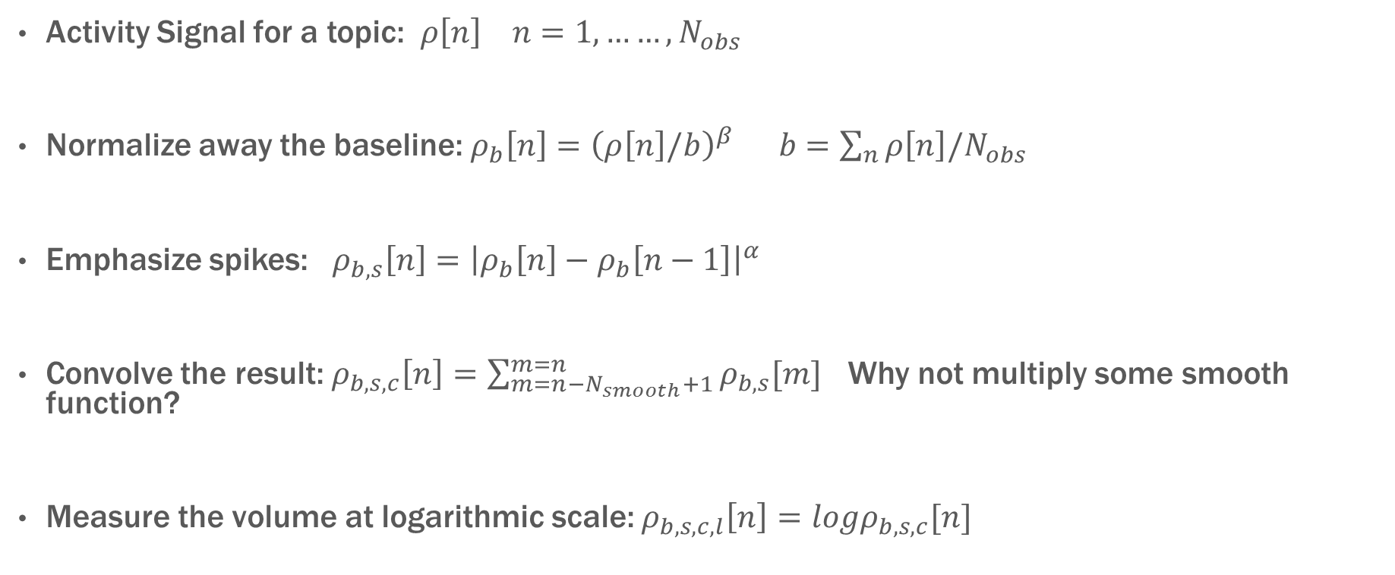
Implementation – Construct Activity Signals
Activity Signal for a topic: $ρ\left[n\right] n=1,……,N_{obs}$
Normalize away the baseline: $ρ_{b}\left[n\right]={\left(ρ\left[n\right]/b\right)}^{β} b=\sum_{n}{ρ\left[n\right]/N_{obs}}$
Emphasize spikes: $ρ_{b,s}\left[n\right]={\left|ρ_{b}\left[n\right]−ρ_{b}\left[n−1\right]\right|}^{α}$
Convolve the result: $ρ_{b,s,c}\left[n\right]=\sum_{m=n−N_{smooth}+1}^{m=n}{ρ_{b,s}[m]}$ Why not multiply some smooth function?
Measure the volume at logarithmic scale: $ρ_{b,s,c,l}\left[n\right]=logρ_{b,s,c}[n]$

Slide 12
Implementation – Construct Reference Signals
Trending Reference Signal:
We select a small slice of the long signal that terminates at the first onset of trend.
Not Trending Reference Signal:
We assume that the rate signal is largely stationary and select the slice with random start and end times.

Slide 13
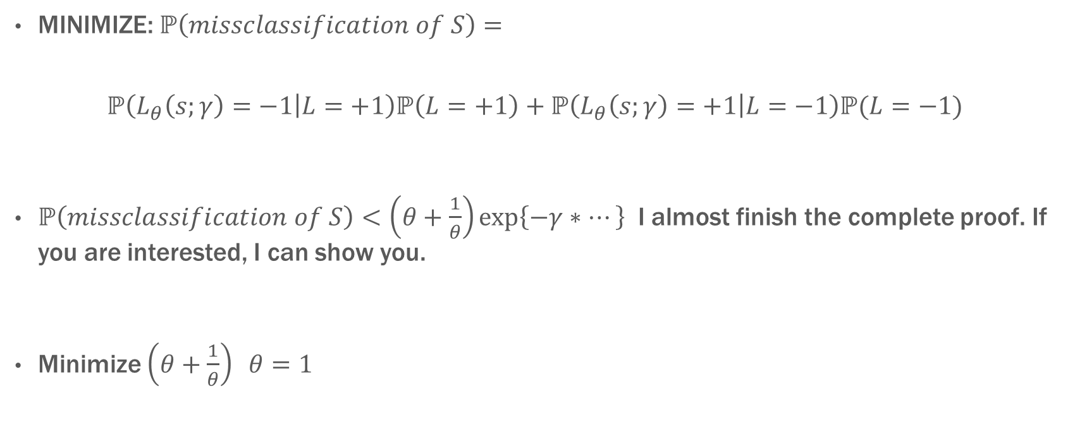
Strategy to Find parameters
MINIMIZE: $ℙ\left(missclassification of S\right)=$
$$ℙ\left(L_{θ}\left(s;γ\right)=−1 | L=+1\right)ℙ\left(L=+1\right)+ℙ\left(L_{θ}\left(s;γ\right)=+1 | L=−1\right)ℙ(L=−1)$$
$ℙ\left(missclassification of S\right)<\left(θ+\frac{1}{θ}\right)\exp\left\{−γ∗…\right\}$ I almost finish the complete proof. If you are interested, I can show you.
Minimize $\left(θ+\frac{1}{θ}\right) θ=1$

Slide 14
Strategy to Find parameters
Simulate ROC curve
Varying one parameter while others are fixed
Compare the early detection with the position
on ROC curve
Effect on Moving ROC curve.

Slide 15
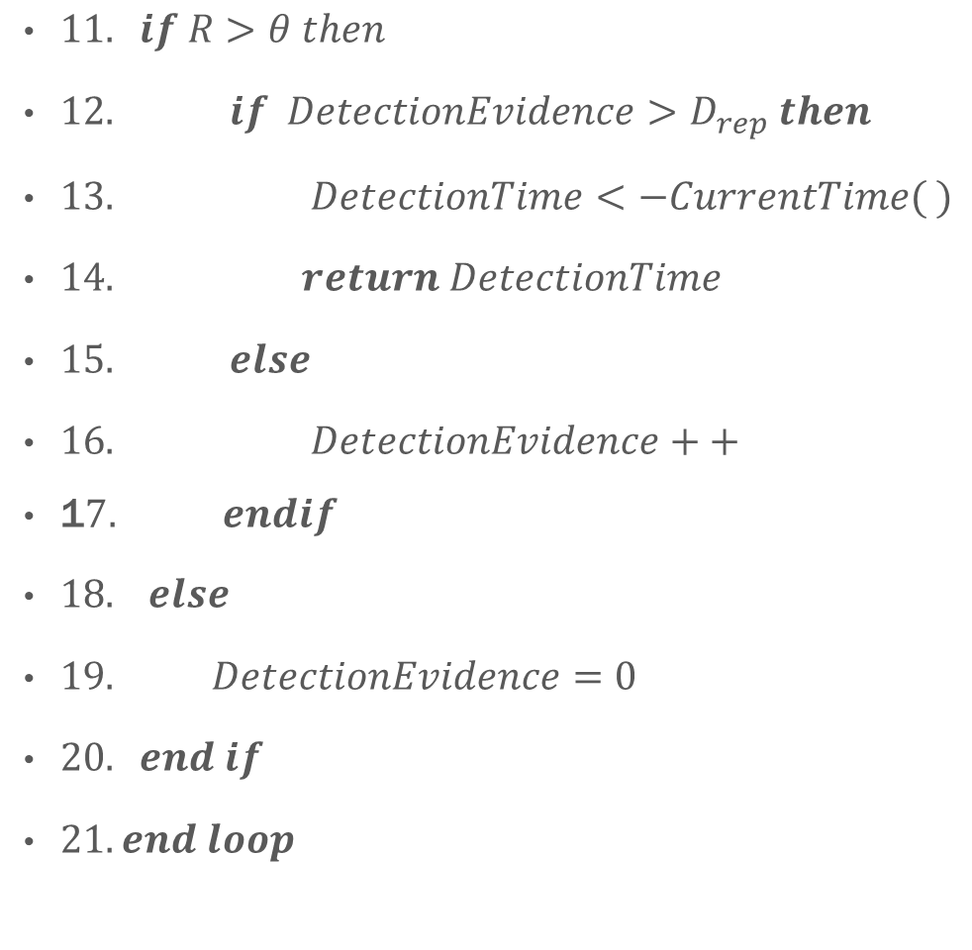
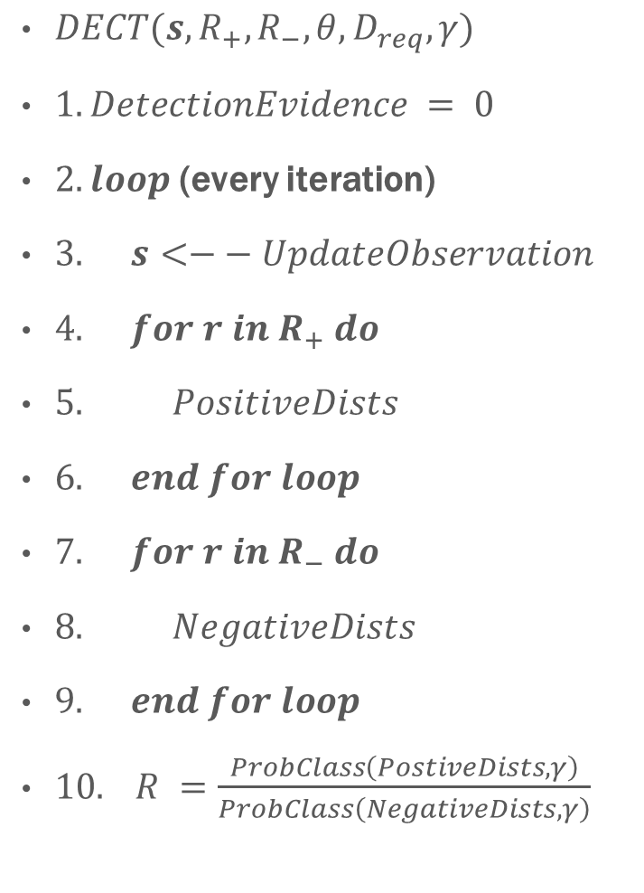
Implementation – Algorithm 1 written by Zhang Zhang
$DECT(s, R_{+},R_{−},θ, D_{req},γ)$
$1. DetectionEvidence = 0$
$2. loop$ (every iteration)
$3. s<−− UpdateObservation$
$4. for r in R_{+} do$
$5. PositiveDists$
$6. end for loop$
$7. for r in R_{−} do$
$8. NegativeDists$
$9. end for loop$
$10. R =\frac{ProbClass\left(PostiveDists, γ\right)}{ProbClass\left(NegativeDists,γ\right)}$
$11. if R>θ then$
$12. if DetectionEvidence>D_{rep} then$
$13. DetectionTime<−CurrentTime( )$
$14. return DetectionTime$
$15. else$
$16. DetectionEvidence++$
1$7. endif$
$18. else$
$19. DetectionEvidence=0$
$20. end if$
$21. end loop$

Slide 16
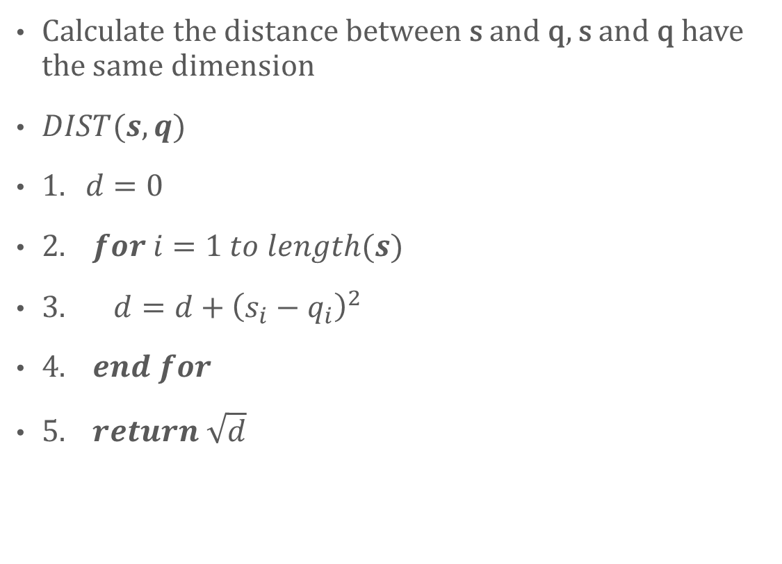
Implementation – Algorithm 2 written by Zhang Zhang
Calculate the distance between s and q, s and q have the same dimension
$DIST(s,q)$
$1. d=0$
$2. for i=1 to length(s)$
$3. d=d+{\left(s_{i}−q_{i}\right)}^{2}$
$4. end for$
$5. return \sqrt{d}$

Slide 17
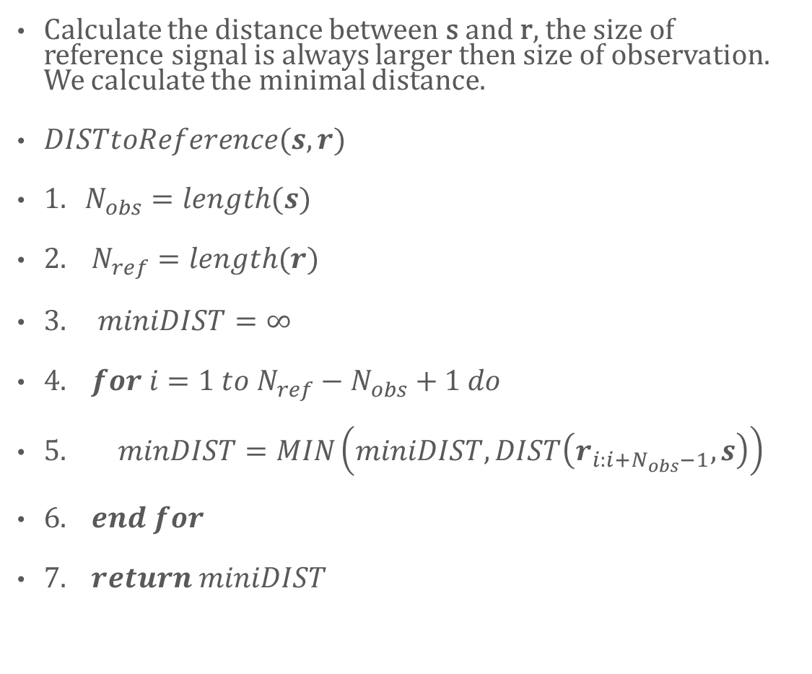
Implementation – Algorithm 3 written by Zhang Zhang
Calculate the distance between s and r, the size of reference signal is always larger then size of observation. We calculate the minimal distance.
$DISTtoReference(s,r)$
$1. N_{obs}=length(s)$
$2. N_{ref}=length(r)$
$3. miniDIST=∞$
$4. for i=1 to N_{ref}−N_{obs}+1 do$
$5. minDIST=MIN\left(miniDIST, DIST\left(r_{i:i+N_{obs}−1},s\right)\right)$
$6. end for$
$7. return miniDIST$

Slide 18
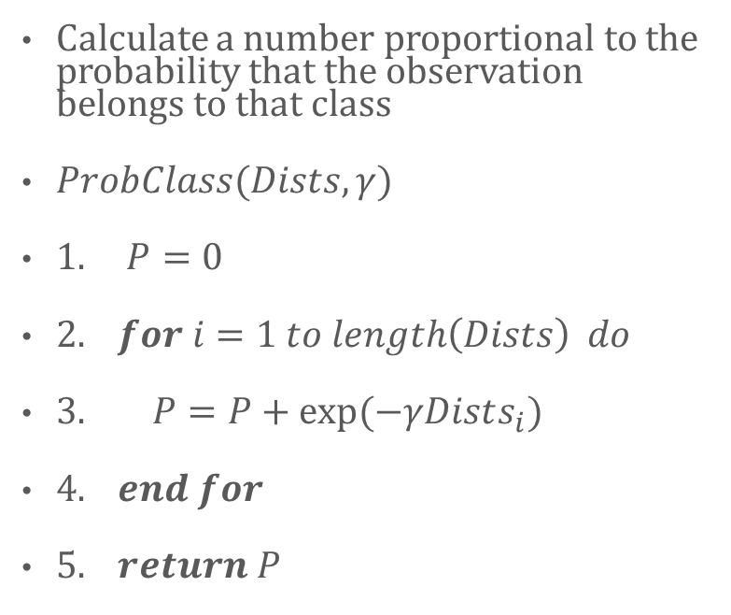
Implementation – Algorithms 4 written by Zhang Zhang
Calculate a number proportional to the probability that the observation belongs to that class
$ProbClass(Dists, γ)$
$1. P=0$
$2. for i=1 to length\left(Dists\right) do$
$3. P=P+exp⁡(−γDists_{i})$
$4. end for$
$5. return P$

Slide 19
Implementation – Parallel Computing
Parallelize the scores for each of the topics
Parallelize each of the reference signal distances for each topic
I have not figured out the algorithm for this parallel part

Slide 20
Validation of Implementation
Use one of the reference signal as the observation signal, and the probability that it belongs to its class is supposed to be nearly 1.
If I increased the time step, then the above test result is supposed to converge to one with smaller error.

Slide 21
Delivery Documentation
Codes of the Software
Enormous data sets
Testing Results
Final Report

Slide 22
Schedule
10/30 Learn Programming language: python
11/30 Write codes to classify data as different topics
12/30 Write codes of algorithm 1-4
1/30 Figure out Parallel Algorithms
2/30 Implement Parralel
3/30 Test
4/30 Write Documents

Slide 23
Reference
@Twitter. (2012). To trend or not to trend. http://blog.twitter.com/2010/12/to-trend-or-not-to-trend.html.
MATHIOUDAKIS, M. K. (2010). Twittermonitor: Trending detection over the twitter stream. ACM SIGMOD International Conference on Management of Data, (pp. 1155-1158). New York.
Shah, S. N. (2011). A nonparametric method for early detection of trending topics. Twitter.
ZHAO, S. V. (2011). Human as real-time sensors of social and phsical events: A case study of twitter and sports games. CoRR, (p. 1106).

Slide 24
Questions?
Thank you!

